Slide 1

Wireless Signal Transmission And LED Control Using RFSoC-PYNQ in Jupyterleb
Thank you
Questions ?
By
Dhaval Kalathiya – 3447615
Maulik Dhorajiya – 3370281
Submitted To
Prof. Dr.-Ing. Florian Aschauer (Asf)
Prof. Dr.-Ing. Susanne Hipp (Hip)

Slide 2
Introduction
Project Overview:
This project demonstrates wireless signal transmission and LED control using RFSoC-PYNQ, leveraging the JupyterLab environment for development and visualization. The system uses RF signal frequencies to control LEDs, enabling a comprehensive demonstration of the RFSoC’s capabilities.
Goal:
Implement wireless RF signal transmission using RFSoC.
Control on-board and external LEDs through received signals.
Extend the implementation to control RGB LEDs via PMOD interfaces.

Slide 3
Motivation and Background
RFSoC Platform Advantages:
High-speed ADCs/DACs.
Programmable logic integration.
Wide applications in IoT and education.
JupyterLab:
Simplified debugging.
Real-time visualization.

Slide 4
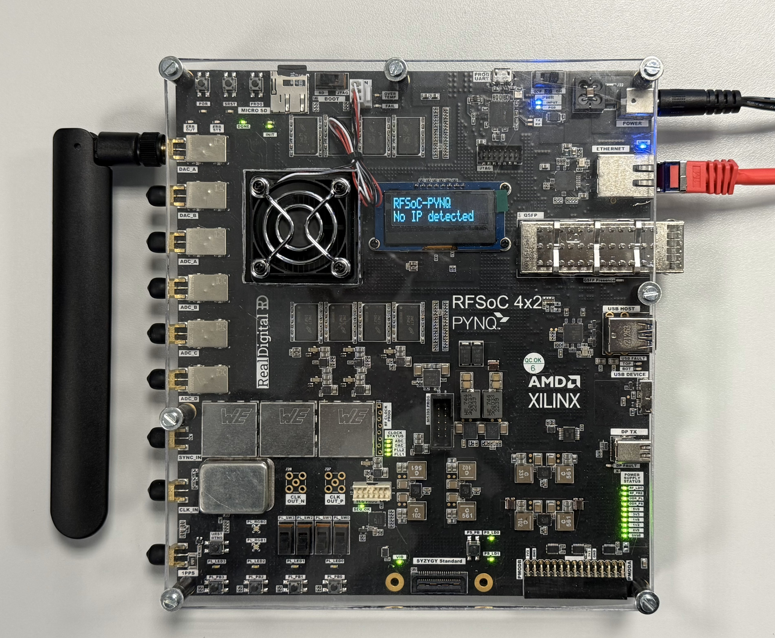
Transmission Setup

Slide 5
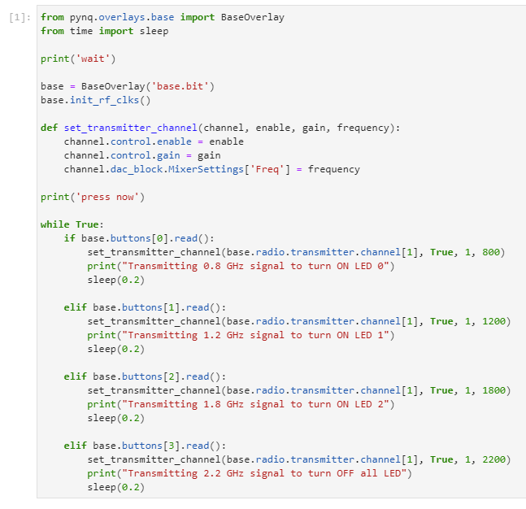
Signal Transmission
Initialization
Function to Configure Transmitter
In the while loop, the code checks if a button is pressed and, when detected, invokes the transmitter function with different frequencies.

Slide 6
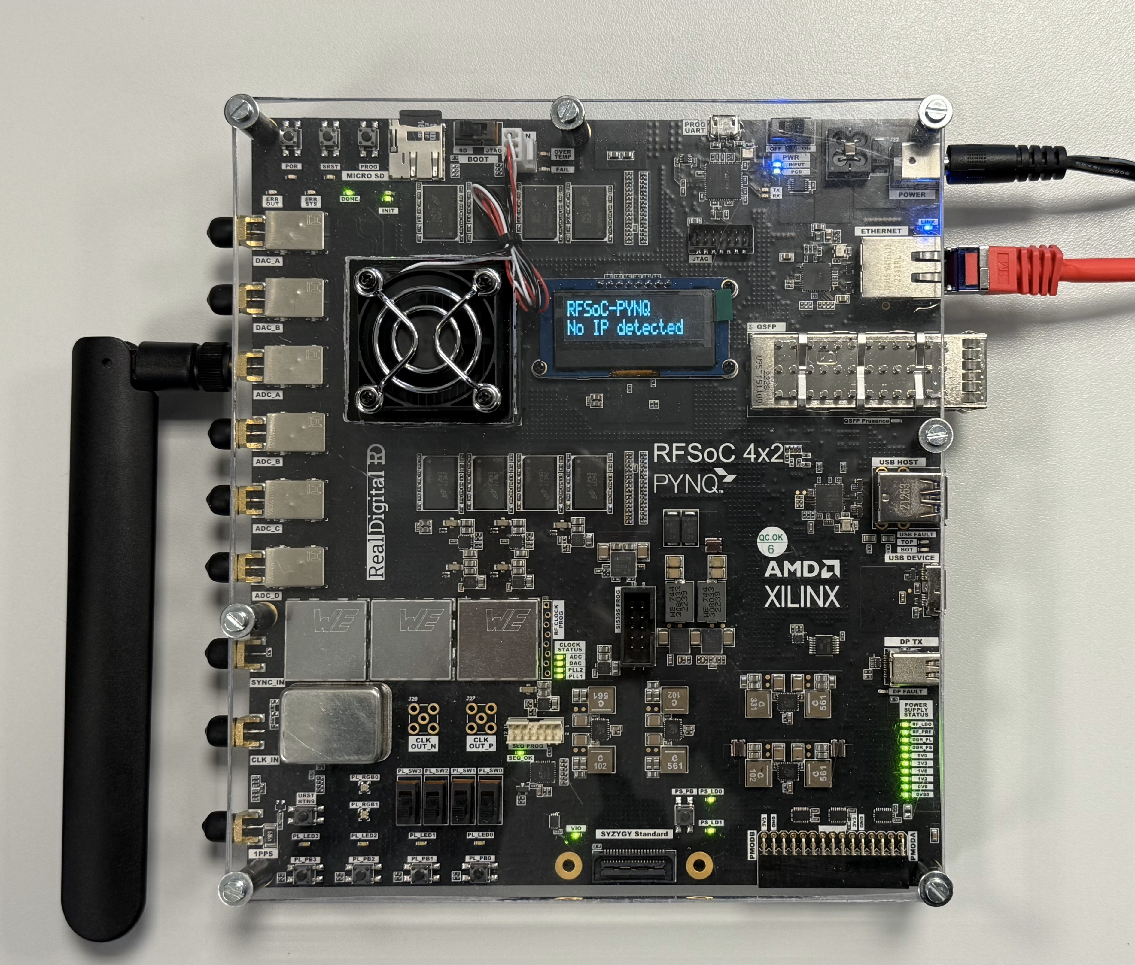
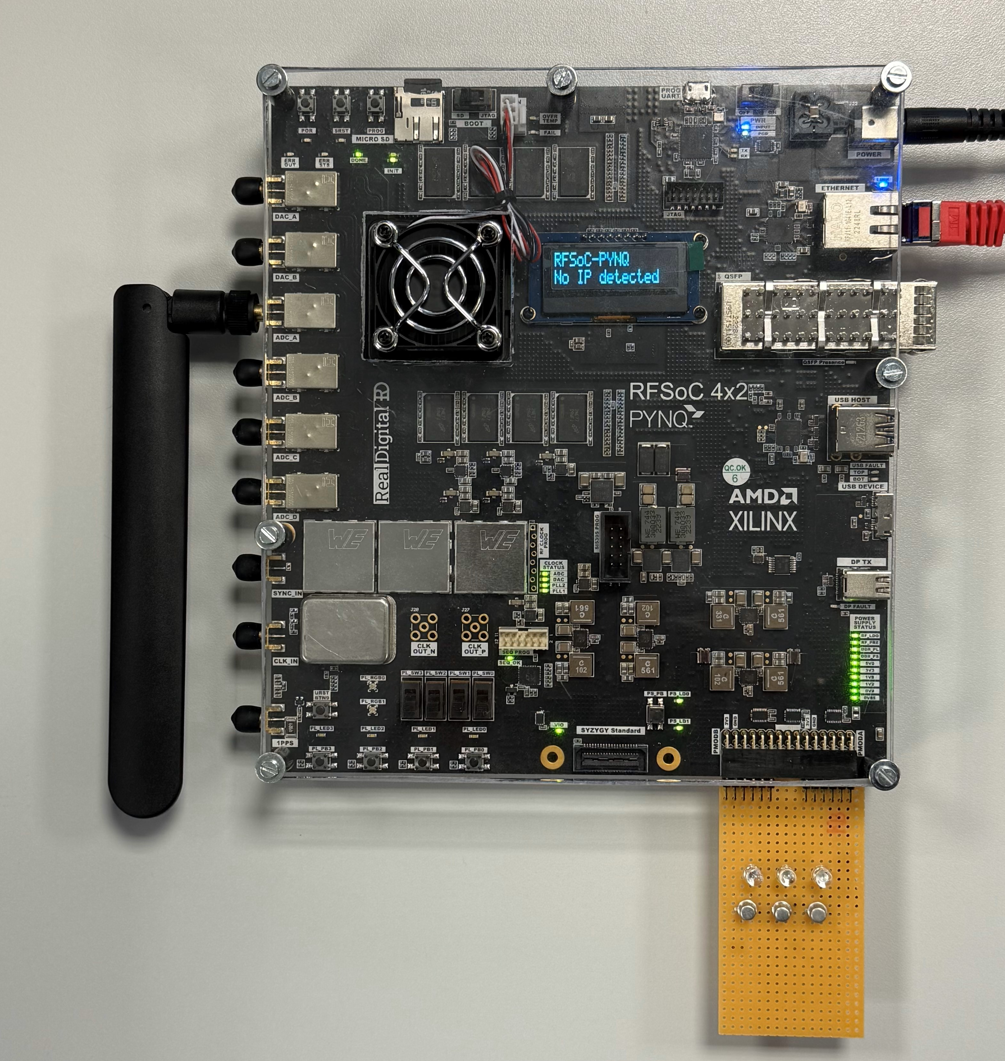
Reception Setup

Slide 7
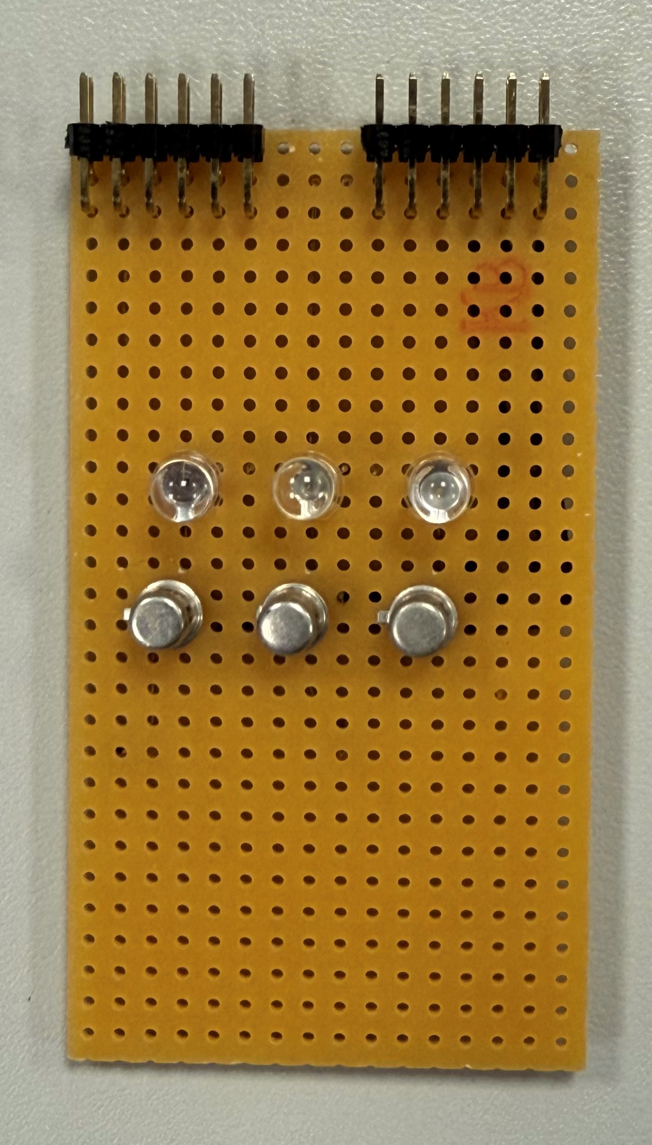
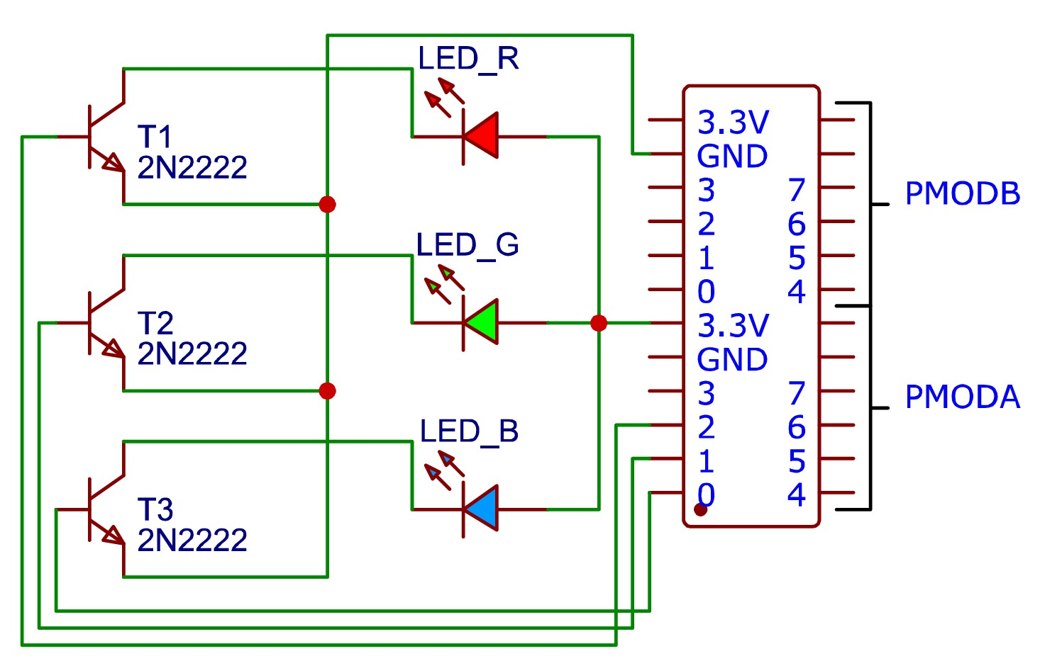
PMOD Circuit

Slide 8
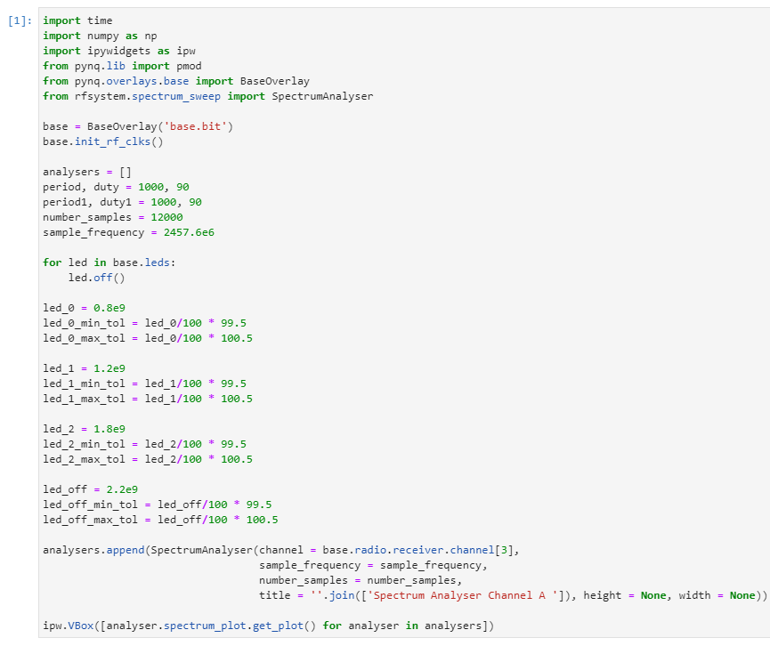
Signal Reception
Initialization
Creates a spectrum analyzer object for the 4th RF receiver channel, configuring it with the specified sample frequency, number of samples, and title, and adds it to the analysers list.
Displays the spectrum plots of all analyzers in the analysers list using an interactive vertical box layout (ipw.VBox).
Using Minimum and Maximum Boundaries as Tolerance

Slide 9
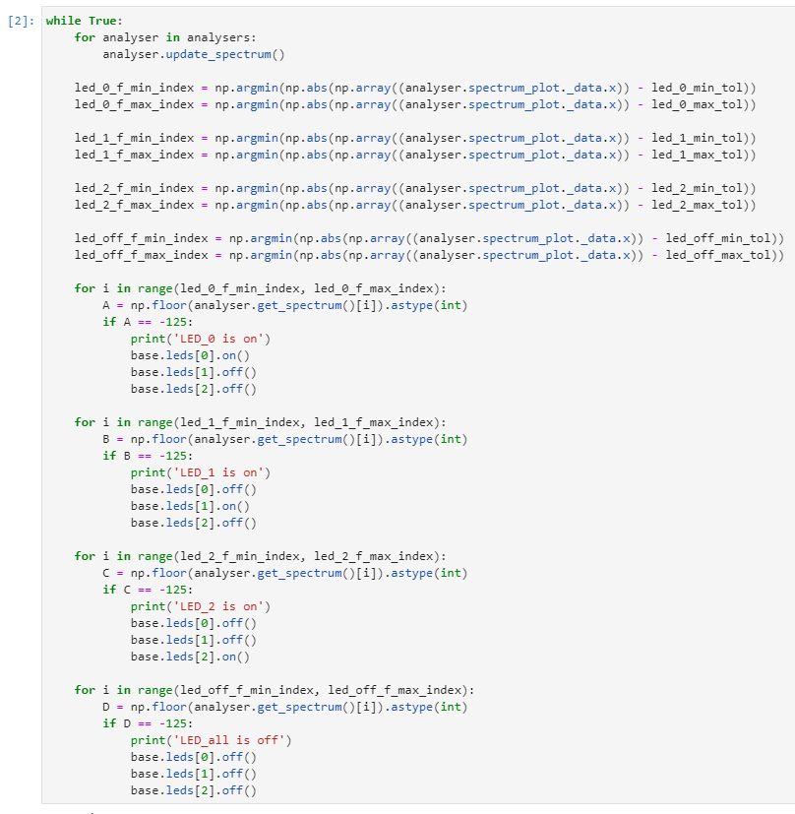
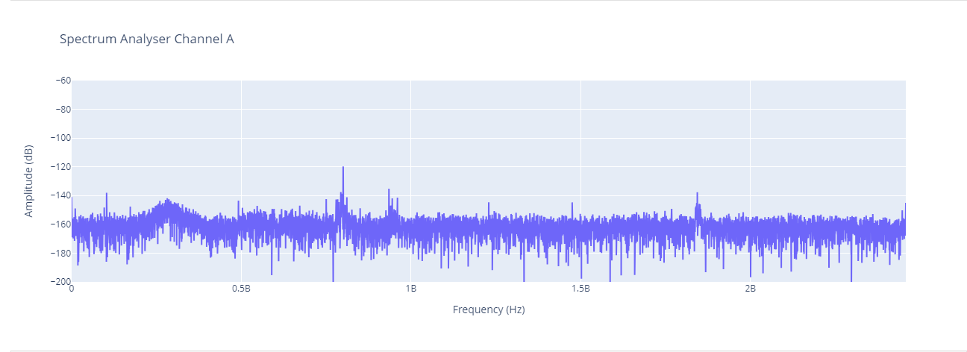
Signal Reception
In the while loop, This logic finds the indices in the spectrum data closest to the frequency bounds (led_b_min_tol and led_b_max_tol).

Slide 10
Signal Reception
In the same while loop, a for loop checks the value of each frequency with an amplitude of -125. If a frequency meets this threshold, it triggers a different function

Slide 11
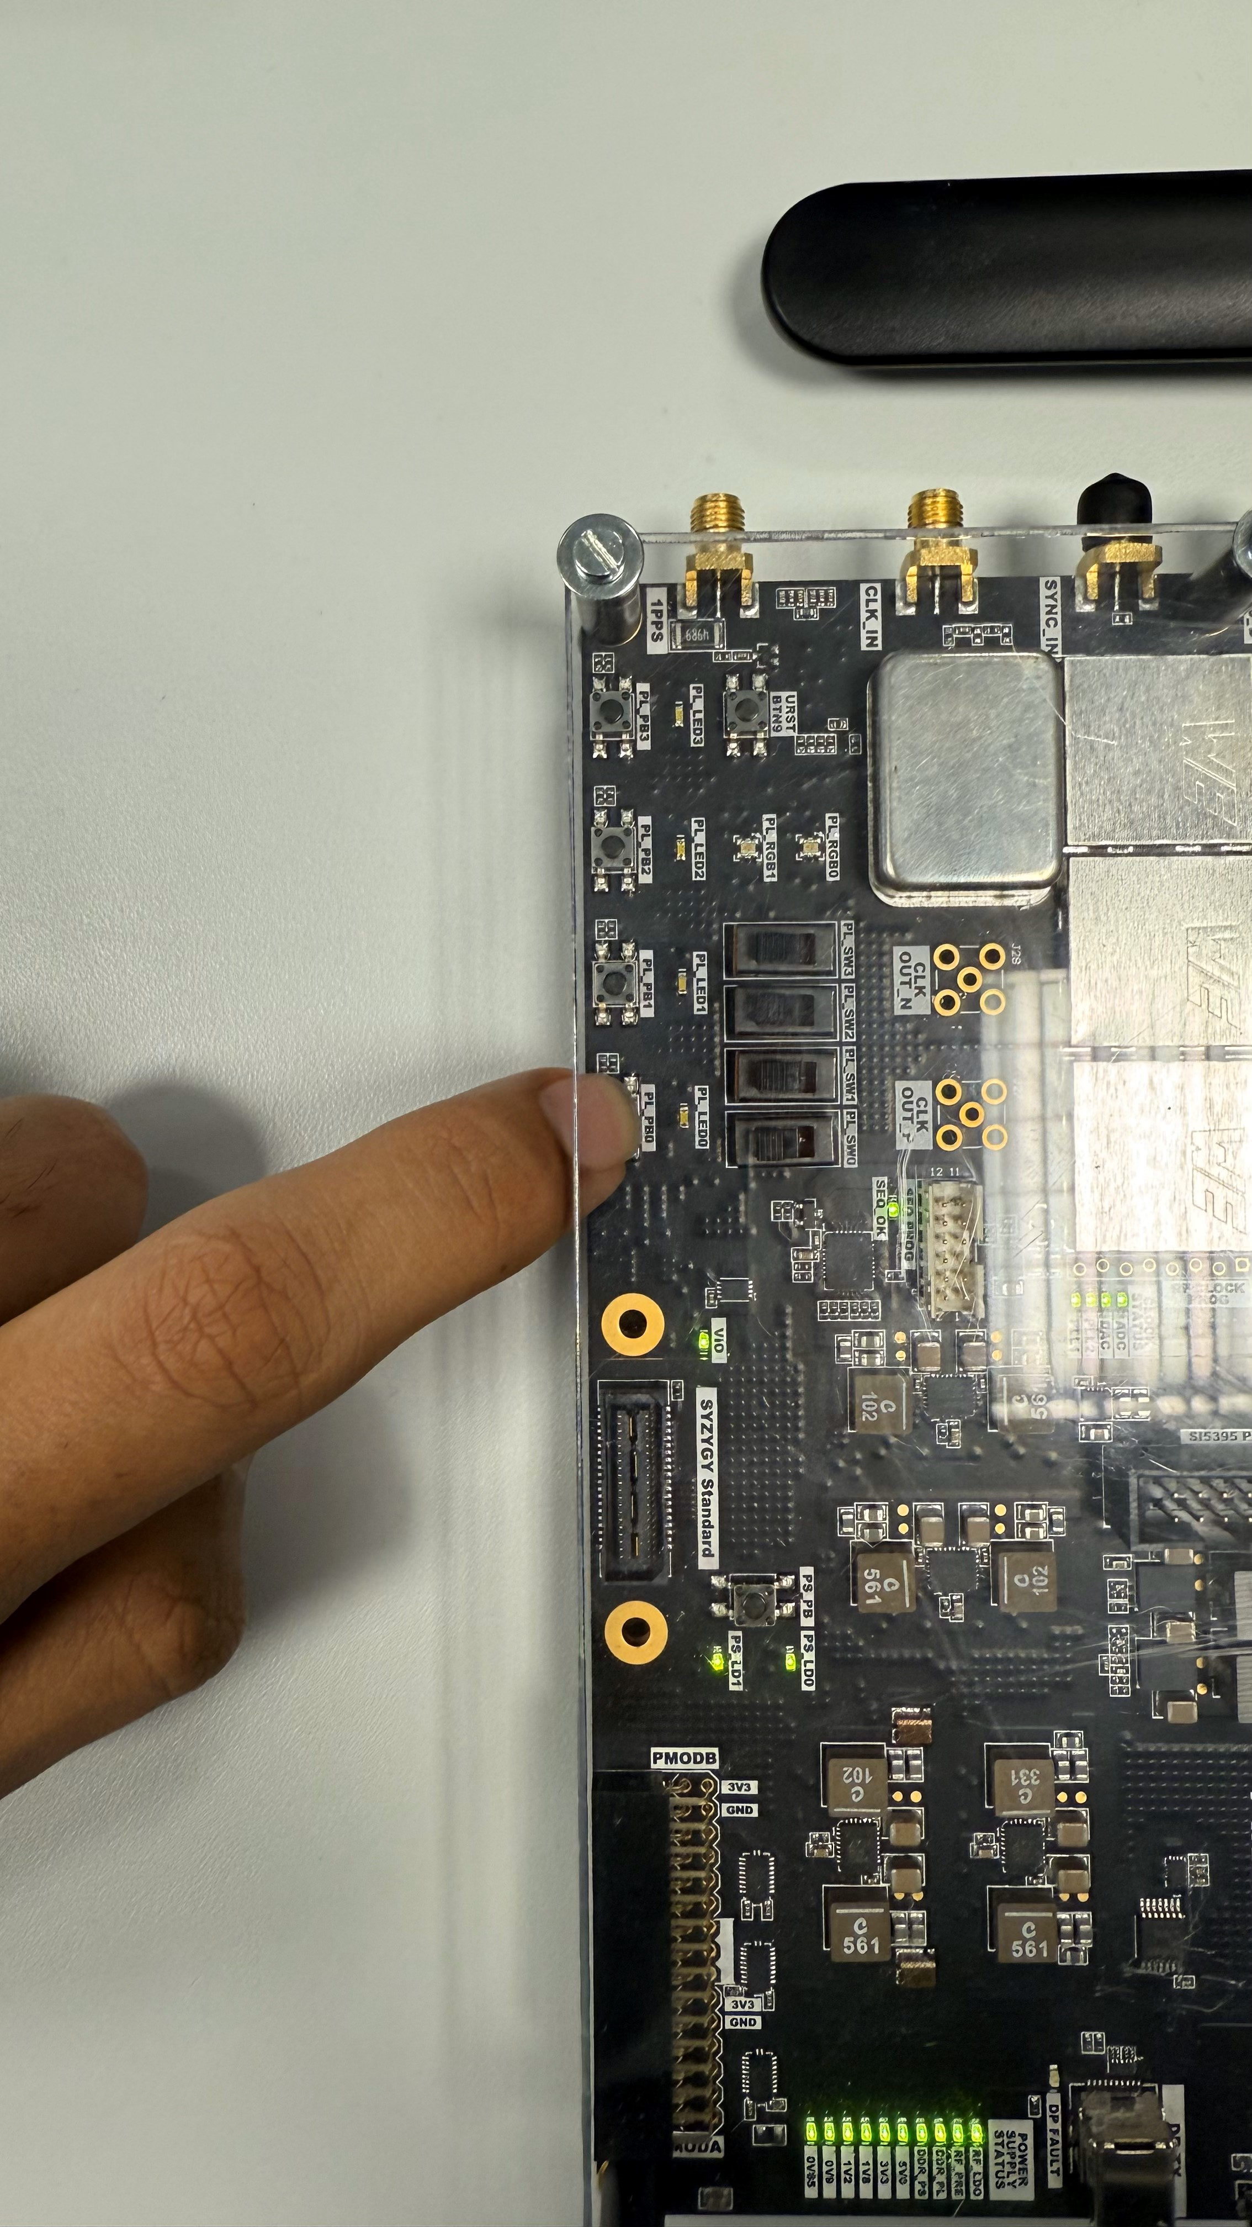
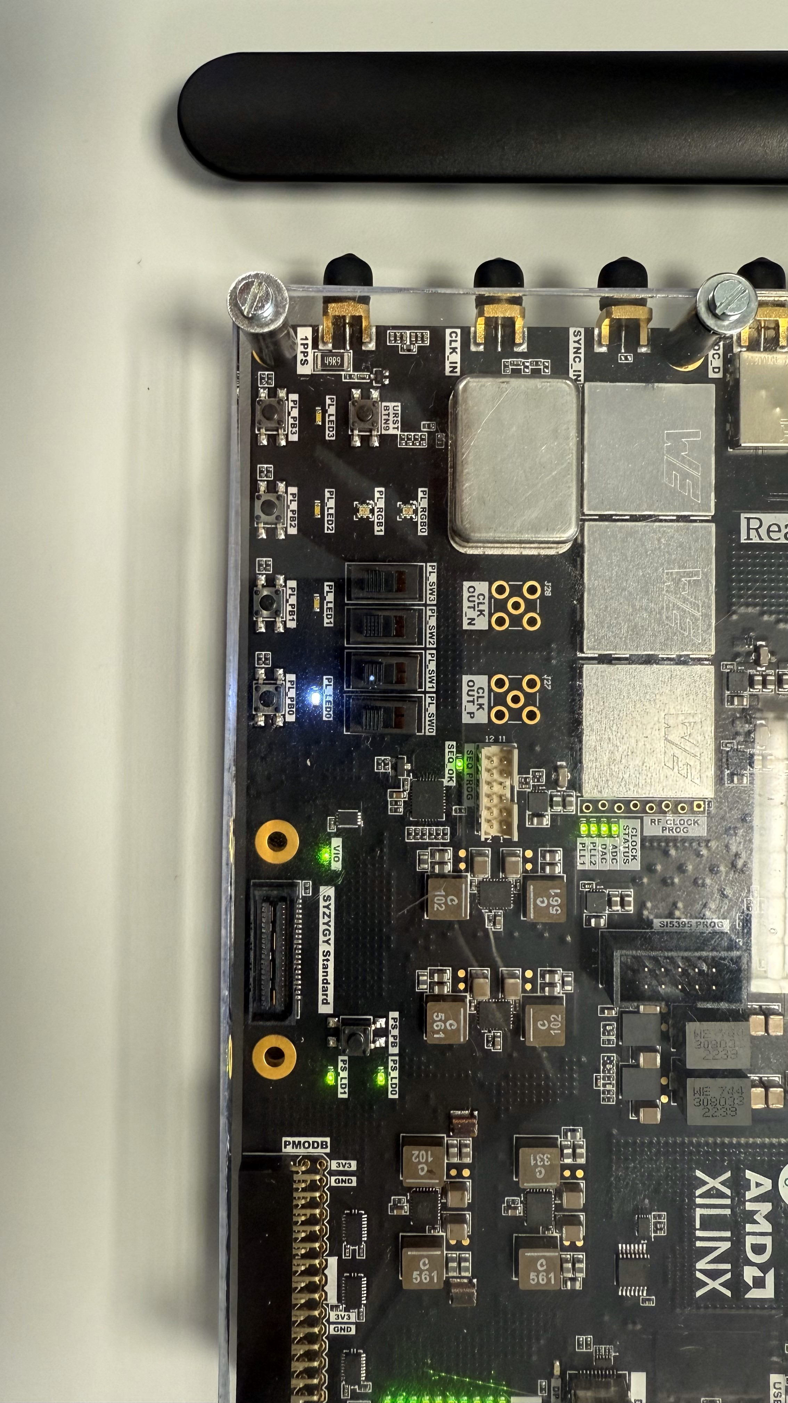
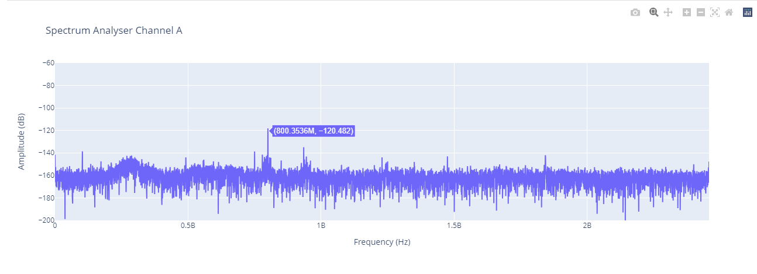
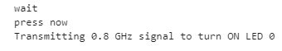
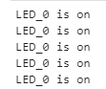
After Detection What ?

Slide 12
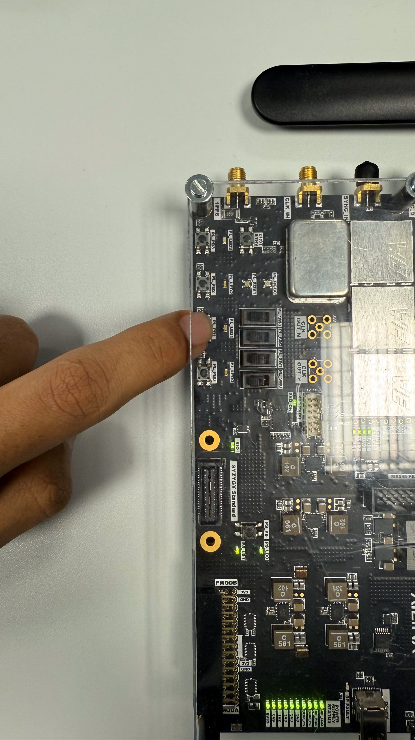
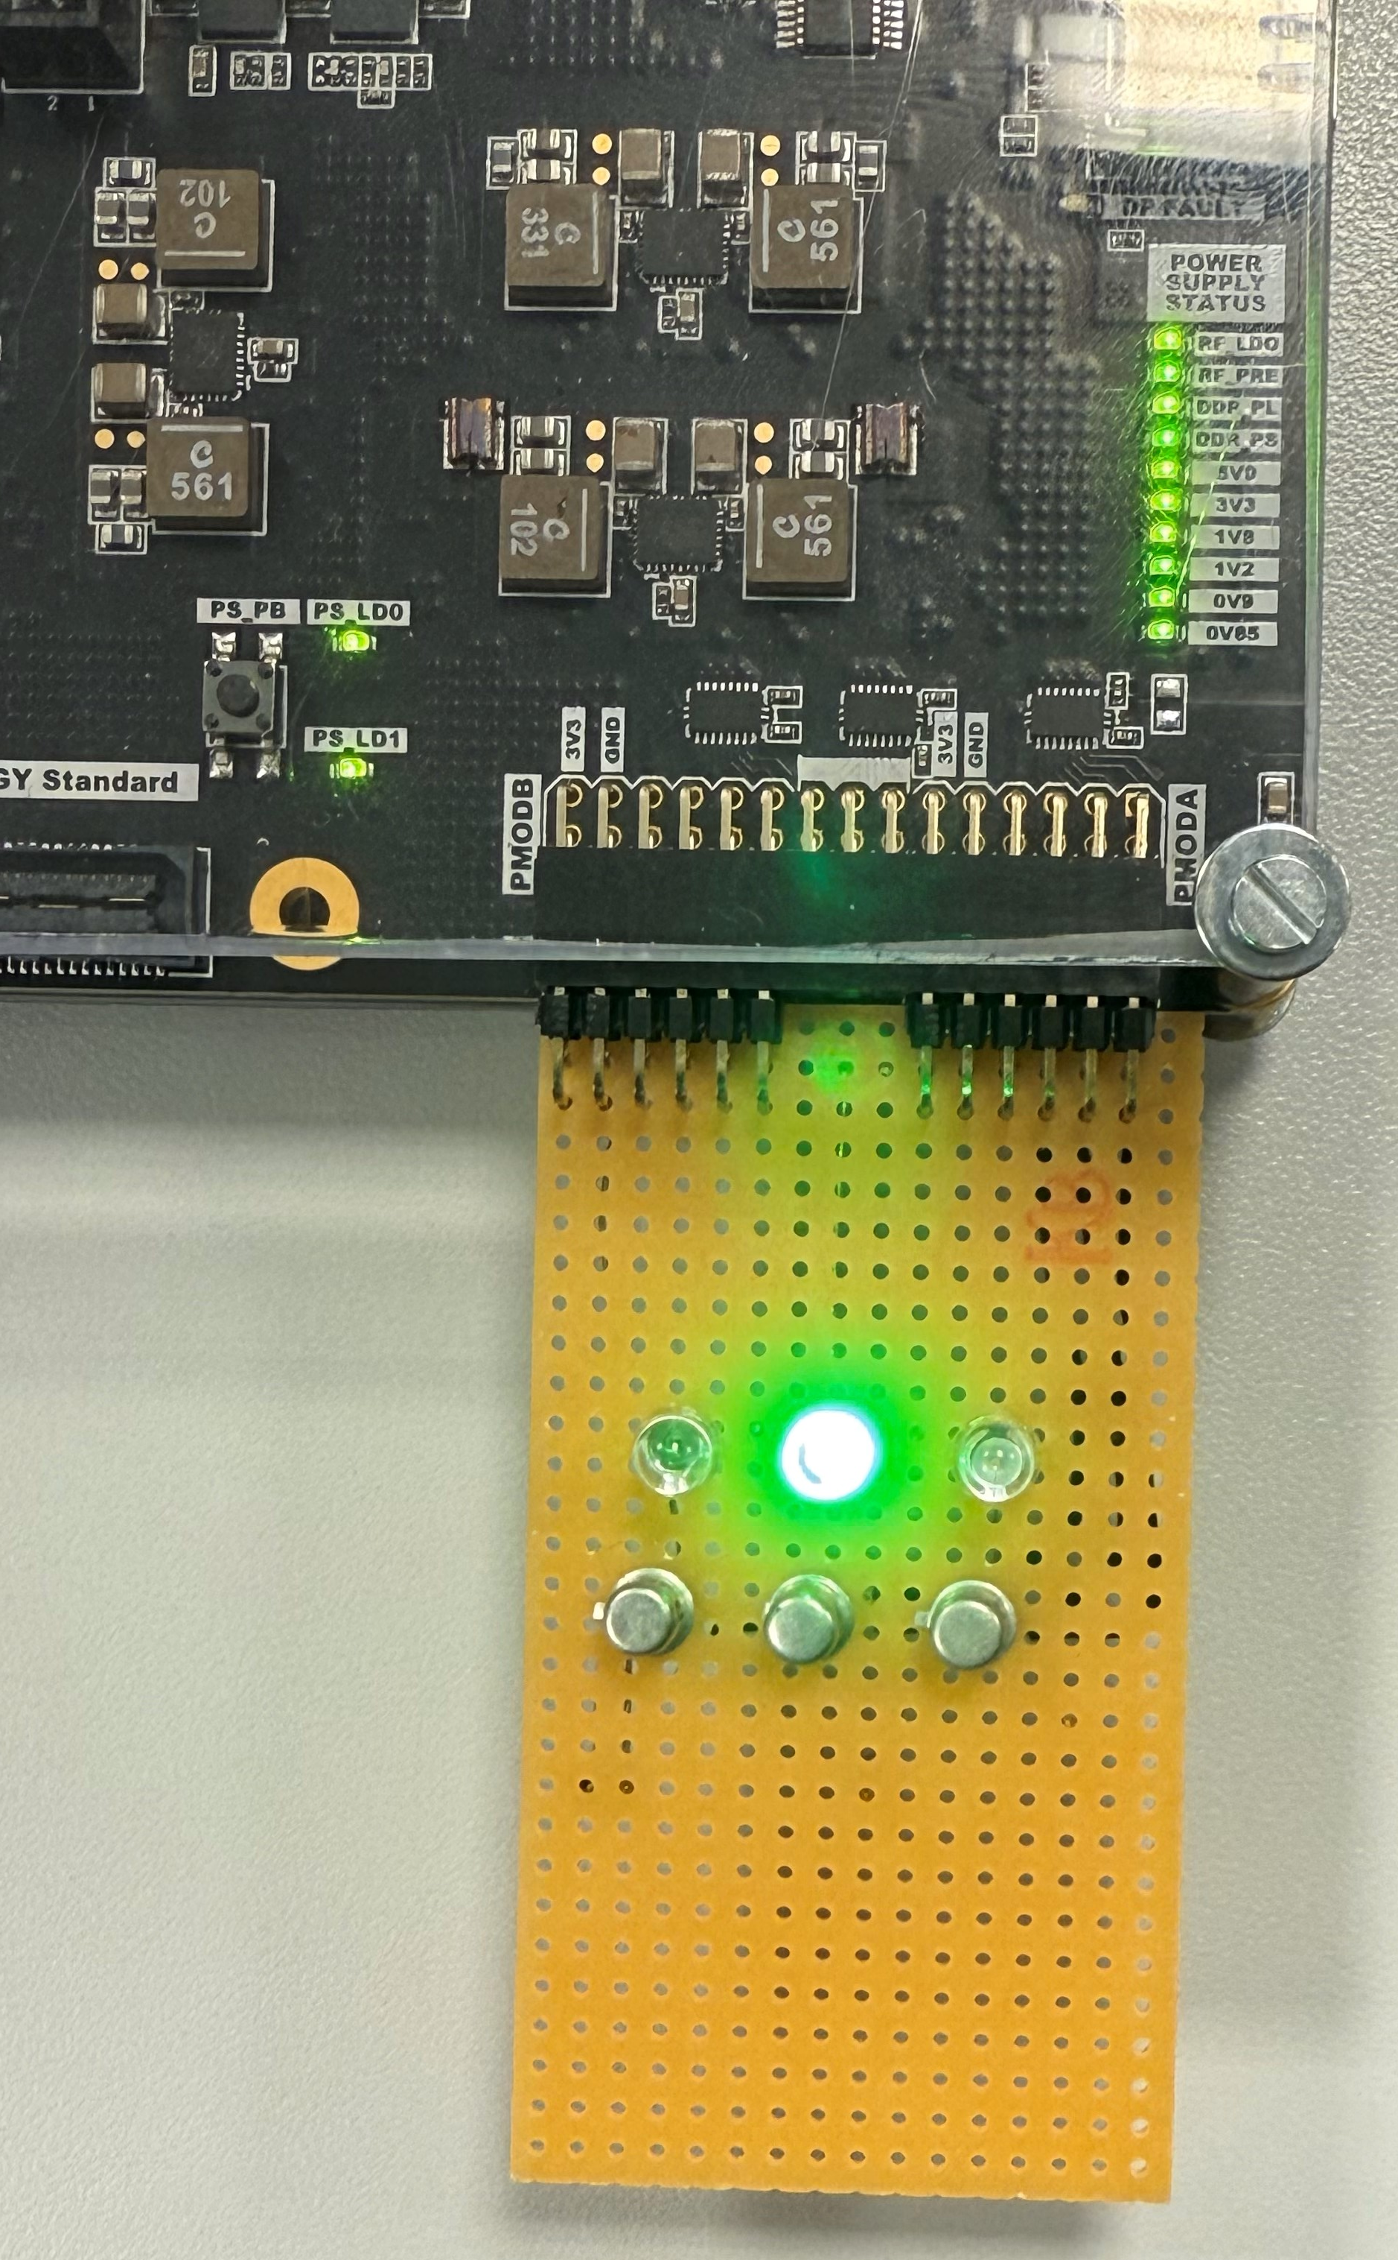
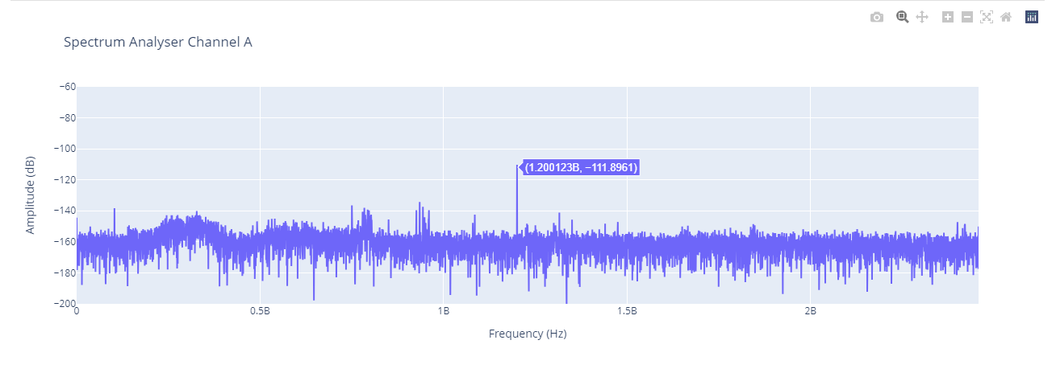
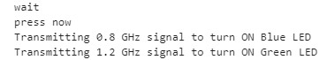
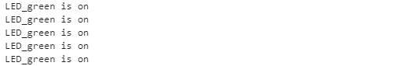
After Detection What ?

Slide 13
Challenges and Solutions
Signal Interference
Interference by nearby RF
Antenna adjustment
RFSoC Resource Utilization
Synchronization between Transmitter and Receiver
Debugging
Trial and Error
Software Debugging
Error in RF signal generation
Real-time spectrum analyzer
Signal Monitoring and Calibration
PMOD Signal Monitoring
Use of Analog Discovery 2

Slide 14
Applications
IoT Devices
Wireless Sensor Network
Educational Platforms

Slide 15
References
L.H. Crockett, D. Northcote, R. W. Stewart (Editors), Software Defined Radio with Zynq UltraScale+ RFSoC, First Edition, Strathclyde Academic Media, 2023. https://www.rfsocbook.com
RFSoC User Guides. Available online: https://www.xilinx.com/support/documentation.html
PYNQ Documentation. Available online: https://pynq.readthedocs.io
Python Libraries: NumPy, Matplotlib, ipywidgets. Documentation available at https://numpy.org and https://matplotlib.org
Circuit Design Software https://easyeda.com/editor
Supporting textbooks and articles on RF design and IoT systems from IEEE Xplore and SpringerLink.

Slide 16
Thank you
Questions ?

